Slide 1
Jell - O
Marketing Strategy
BADM 520 - Group 6 MarkeTechs
October 14, 2024
Debadrita Dey; Saurabh Vinod Ghumnar; Shambhavi Satish Patil; Vaishnavi Giramkar; Yen-Ling Liu

Slide 2
Team Members
Debadrita Dey
Saurabh Vinod Ghumnar
Shambhavi Satish Patil
Vaishnavi Giramkar
Yen-Ling Liu

Slide 3

Agenda
Team Overview | 2
Problem Statement and Proposal | 4
5Cs Framework | 5
PESTEL(E) Analysis | 6
SWOT Analysis | 7
Strategic Recommendations and Marketing Objectives | 8
Mission Statement | 11
Brand Ladder and Positioning Statement | 12
Target Market | 14
Target Customer Segment | 15
Marketing Mix | 16
Financial Projections | 17
Implementation | 19
Evaluation and Control | 20
Appendix | 21
Survey Data | 22

Slide 4
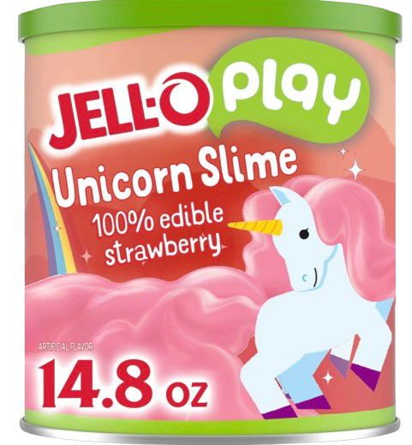
Jell - O Problem Statement
Proposal
Jell-O is struggling to engage younger consumers and families in an era focused on interactive, sensory-driven experiences. The brand must reinvent itself to stay relevant while maintaining its fun, edible product image.
We propose focusing on the JELL-O PLAY Edible Slime line to tap into the slime trend. This product combines play and taste, appealing to families seeking creative, sensory activities. With easy prep, safety features, and social media-driven marketing, this strategy will modernize Jell-O and attract a new generation, blending nostalgia with today's interactive preferences.
Image taken from https://images.app.goo.gl/Fjk1pi4zjagsgWb28
Notes:
As we all know Jell-O is a slime dessert which used to be house hold staple previously but with changing consumer trends, Jell-O is facing a hard time maintining its market. Based on it we have proposed Jell-O Play Edible line combining play and taste, appealing to families. seeking creative and sensory activity. Along with Social media driven marketing, we emphasise on blending nostalgia with today's. interactive preferences.

Slide 5






5Cs Framework
COMPANY
CUSTOMER
COMPETITORS
COLLABORATORS
CONTEXT
Involves analyzing the broader macro-environmental factors that affect Jell-O’s marketing strategy.
Include societal trends, economic conditions, regulatory factors, technological advances, and environmental concerns.
Revitalize Jell-O Brand
Strong distribution network, brand recognition and expertise in food manufacturing
Perceived as outdated, not aligned with health concious trends
Families with children, millennial parents
Fun creative snacks and nostalgia
Health focus marketplaces is the key
Itensity of rivalry among existing players like Royal Gelatin and Simply Delish
Competitors focus heavily on health, eco-friendly packaging
The rise of healthier snack alternatives and innovative dessert brands
Large-scale suppliers for ingredients
Supermarkets, online platforms and fun, creative marketing agencies
Expanding online and partnering with subscription snack boxes
Citations:
[1] https://www.cnn.com/2022/11/19/business/jell-o-america-dessert-ctpr/index.html
[2] https://www.statista.com/statistics/1361137/leading-desert-mix-companies-in-the-united-states

Slide 6







PESTEL(E) Analysis
Shift in consumer preferences toward healthier and more convenient snack options.
Strong nostalgic appeal among older generations but limited relevance for younger consumers.
Innovations in food science can enable healthier, plant-based, and sugar-free versions.
Growing digital engagement opportunities through interactive and social media-driven campaigns.
Social
Technological
Rising costs of raw materials & inflation impacting pricing & production.
Consumer price sensitivity affecting demand for non-essential food items like Jell-O.
Increasing demand for eco-friendly, recyclable, or biodegradable packaging.
Pressure to source ingredients responsibly and reduce carbon footprint.
PESTEL(E)
Analysis
Economic
Environmental
Strict food safety & labeling regulations requiring transparency in ingredients.
Trade policies influencing ingredient sourcing & global supply chain management.
Compliance with global food safety standards and regulations on artificial additives.
Legal scrutiny around product labeling and potential allergens.
Political
Legal
Ethical
Use of animal-based gelatin; potential for plant-based alternatives.
Addressing health concerns related to sugar content and artificial ingredients.

Slide 7

SWOT Analysis
Strengths
Weakness
Brand Reputation
Product Variety
Convenience
Perception of Being Outdated
Nutritional Value
Limited Innovation
Opportunities
Threats
Innovative Flavors & Textures
Collaborations & Limited Editions
International Market
Health-Conscious Trends
Competition
Economic Downturns
Jell-O must embrace innovation and align with current trends
to combat competition, retain consumer interest, and ensure future growth.

Slide 8
Reformed Branding with Emotional connect
Make use of emotional standing by emphasizing ties to family and memories. Make ads that remind people of their early years and family get-togethers, emphasizing Jell-O as a quick and enjoyable dessert to create memorable experiences.
Consumers are more likely to be loyal and attached to brands that they can relate to on an emotional level, preference being influenced by nostalgia.
Promotional Events
Experience Marketing creates interactive experiences for consumers, such as pop-up events or cooking competitions, where they may interact with Jell-O in entertaining and unique ways
Consumer experience is critical in developing brand loyalty, high-quality experiences across various interactions build trust.
Product Expansion
Innovate and create new products and line extensions aligning with current health and food trends like vegan, low sugar providing a healthier option.
New varieties help in acquiring different market segments and address changing consumer preferences.

Slide 9
Social Media & Digital Expansion
Elevate Jell-O’s social media presence, engage new age influencers, and broaden appeal among young kids and parents by offering diversified products.
Consumers favorite influencers or actors endorsing a product increase engagement, and expand market reach.
Jell-O’s Sustainable Packaging
Carry out sustainable practices in production and packaging of Jell-O products and promote sustainable and eco-friendly initiatives.
Collaborate with eco-conscious companies to strengthen adherence to sustainability and become socially responsible.
Drawbacks
Outdated approaches can be ineffective if not properly implemented.
Initiatives often require significant financial resources, which may not be universally supported.
Brand extensions can weaken brand identity and value if not strategically managed.
Efforts toward sustainability may involve high costs and financial risks.

Slide 10
Marketing Objectives
Sustainable Innovation
Sustainable Innovation - Develop eco-friendly packaging to replace 80% of non-eco-friendly materials.
Social Media Presence
Work with top famous influencers to increase followers and analyze engagement metrics.
Product Line Extension
Launch 2 new product lines within a year, with a target of capturing 5% market share.
Emotional Branding
Increase brand sentiment by 20% within a year, measured by customer surveys and social media sentiment analysis.
Promotions
Achieve increased participation rate of consumers at promotional events, reporting positive experiences.

Slide 11
Mission Statement
"Jell-O inspires moments of happiness and creativity with tasty, playful sweets. Our objective is to thrill people of all ages with vibrant flavors and exciting experiences, all while adopting innovation and sustainability to build a brighter, more joyful future."

Slide 12
Brand Ladder
EMOTIONAL BENEFITS
Nostalgic comfort
Playful excitement
Carefree indulgence
Shared family joy
FUNCTIONAL BENEFITS
Versatile dessert option
Convenient dessert solution
Interactive food experience
Nutritional flexibility (sugar-free options)
Engaging sensory experience
ATTRIBUTES
Colorful gelatin dessert
Easy to prepare
Affordable treat
Edible toy (slime)
Jiggly texture

Slide 13

Positioning Statement
Among families with young children and nostalgic adults, Jell-O is the brand of versatile gelatin desserts that transforms ordinary moments into playful experiences because of its fun textures, interactive formats, and ability to evoke cherished memories.
Image taken from https://www.instacart.com/products/19235975-jell-o-unicorn-slime-kit-with-100-edible-strawberry-gelatin-mix-14-8-oz
Notes:
based on our survey results, we have positioned our product as …

Slide 14
Target Market
Demographic
Geographic
Psychographic
Age: Primarily parents aged 25-44
Children: Families with children aged 3-12
Income: Middle to upper-income households, with 32% earning $150,000 or more annually
Location: Focus on urban and suburban areas with high family concentrations
Focus on urban and suburban areas with high concentrations of families
Initial launch in regions with strong retail presence and family-oriented communities
Safety-Conscious: Highly value safe, edible products for their children
Family-Oriented: Seek interactive and shared family experiences
Convenience-Seeking: Prefer easy-to-use products that fit into busy lifestyles
References:
[1] https://www.creativedemand.org/blog/the-fall-of-jell-o-and-how-to-stay-relevant-in-a-changing-marketplace
[2] https://www.brandvm.com/post/jell-o-marketing
[3] https://www.packworld.com/leaders-new/materials/cartons-boxes/article/13377088/jello-brings-family-creativity-and-play-to-the-food-aisle
Notes:
Our primary demographic focuses on parents aged 25-44 with children between 3 and 12 years old. We're targeting middle to upper-income households, with 32% earning $150,000 or more annually. Geographically, we're concentrating on urban and suburban areas with high family concentrations.
Psychographically, our customers are safety-conscious parents who value safe, edible products for their children. They're family-oriented, seeking interactive experiences, and prefer convenient, easy-to-use products that fit their busy lifestyles.

Slide 15
Target Customer Segment
Appeal to those seeking healthier snack options with no artificial flavors or dyes
95% of respondents are key decision- makers for children's snacks
Safety is a top priority; JELL-O PLAY Edible Slime is 100% edible
32% have children under 6; 21% have kids aged 6-12
95% of respondents are parents/guardians making purchasing decisions
Influenced by social media trends & friend/ family recommendations
Easy-to-make product aligns with busy family lifestyles
Safety and flavor are top priorities for new products
Based on Survey Results
Notes:
Sarah, a 35-year-old married mother with two children aged 6 and 8. She works full-time and values products that offer both entertainment and educational benefits for her kids. Sarah is health-conscious and prioritizes safe, non-toxic play options for her children. In her free time, she enjoys engaging in creative activities with her kids, making JELL-O PLAY Edible Slime an ideal product for her family

Slide 16




Marketing Mix
Product
Price
Place
Promotion
JELL-O PLAY Edible Slime combines play and taste.
Safe, 100% edible, with unique flavors like strawberry Unicorn and lime Monster.
Easy-to-make, promoting creativity and family bonding.
Available in supermarkets and online platforms like Amazon.
Focus on urban and suburban areas with high family concentrations.
In-store displays and online presence to maximize accessibility.
Social media campaigns targeting parents aged 25-44.
Influencer partnerships and in-store sampling events.
Loyalty programs and referral incentives to encourage repeat purchases.
Priced at $9.99 per canister.
Offers value packs and introductory discounts.
Positioned as a premium product due to its unique play-and-eat concept.
Notes:
Product: JELL-O PLAY Edible Slime combines play and taste. It's 100% safe and edible, featuring unique flavors like strawberry Unicorn and lime Monster. This easy-to-make product promotes creativity and family bondin
Price: We've set the price at $9.99 per canister, positioning it as a premium product due to its unique play-and-eat concept. We'll offer value packs and introductory discounts to encourage trial.
Place: The product will be available in supermarkets and online platforms like Amazon, focusing on areas with high family concentrations. We'll use in-store displays and maintain a strong online presence to maximize accessibility.
Promotion: Our strategy includes social media campaigns targeting parents aged 25-44, influencer partnerships, and in-store sampling events. We'll also implement loyalty programs and referral incentives to encourage repeat purchases.

Slide 17
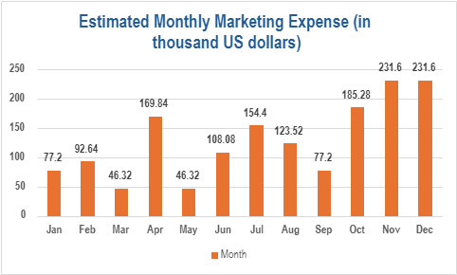
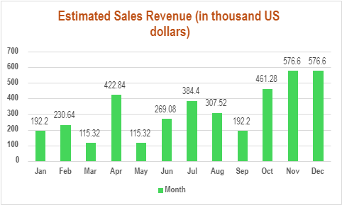
Financial Projections
FIRST YEAR PROJECTIONS
Total Promotional Marketing Budget = $1,544,000
Total Annual Revenue for Jell-O = $3,844,000
Annual Projected MROI = 7
Based on the projections, Jell-O can achieve break-even for its marketing costs by the month of July, assuming January as starting period.
Notes:
Coming to financial projections of Jell-O,
Kraft Heinz does not specifically break out marketing spend for individual brands like Jell-O in its public financial statements.
However, we can gather from its broader financial disclosures that the company made significant investments in marketing
Based on the previous income statement, Kraft Heinz’s Marketing Budget for upcoming year will be approximately 772 million US$.
Jell-O is part of the “easy indulgent desserts” which contributes to 4% of the company.
Assuming Jell-O Slime shares 5% of this category, the marketing budget for Jell-O slime for upcoming year should be 1.544 million US$
Kraft Heinz’s Net Income estimation will be approximately 1922 million US$.
Considering the same proportions as above, Jell-O sales will amount to a revenue of 3.844 million US$ with average price ranging 9.99$ per 14.8 oz canister

Slide 18
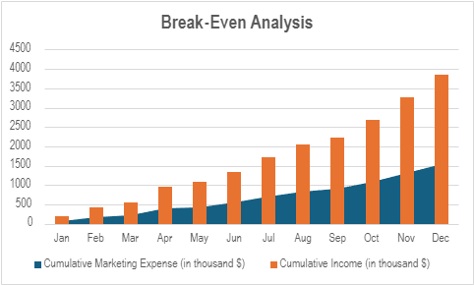
Financial Projections
Break-Even Analysis
Kraft Heinz’s Marketing Budget for upcoming year will be approximately 772 million US$.
Jell-O is part of the “easy indulgent desserts” which contributes to 4% of the company. Assuming Jell-O Slime shares 5% of this category, the marketing budget for Jell-O slime for upcoming year should be 1.544 million US$
Kraft Heinz’s Net Income estimation will be approximately 1922 million US$.
Considering the same proportions as above, Jell-O sales will amount to a revenue of 3.844 million US$
After distributing the marketing expense and revenue monthly (depending on the seasonal demand fluctuations) as seen in graphs, we conclude that the Jell-O slime will reach break-even in 7 months
References:
[1] https://finance.yahoo.com/quote/KHC/financials/
[2] https://www.cnn.com/2022/11/19/business/jell-o-america-dessert-ctpr/index.html
Notes:
Based on our survey, 40% of our customers link it to holiday gatherings and party treats.
This leads us to higher demand in summers and festive and celebratory occasions such as Halloween, Thanksgiving and Christmas.
After distributing the marketing expense and revenue monthly (depending on the seasonal demand fluctuations) as seen in graphs, we conclude that the Jell-O slime will
reach break-even in 7 months.

Slide 19
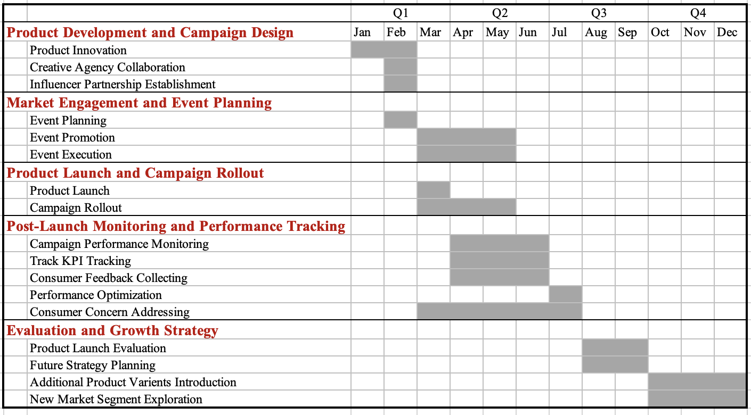
Implementation

Slide 20
Evaluation and Control
Objective | KPI | Remediation Plan
Increase sales through new channels | Sales Growth in E-commerce & Direct-to-Consumer | Partner with subscription boxes or offer exclusive online-only flavors.
Improve product quality perception | Net Promoter Score (NPS) | Implement a loyalty program that rewards feedback and product suggestions.
Increase brand visibility | Brand Mentions & PR Coverage | Host interactive pop-up events and collaborate with influencers or schools for slime-making workshops.
Expand product line appeal | Product Variety Sales Mix | Introduce seasonal or themed varieties (e.g., Halloween, summer BBQ editions).
Enhance eco-friendly reputation | Use of Sustainable Packaging | Shift to biodegradable packaging and promote eco-friendly initiatives on social media.
Notes:
Now we will see how Jell-O's performance will be monitored and improved with the plan of Evaluation & control.
We have objectives & their corresponding KPIs & plans
1st objective is to increase sales through new channels. Jello will partner with subscription or offer exclusive online only flavors to attract customers.
2nd is to boost brand visibility
We’ll measure brand mentions & PR coverage. We plan to do interactive pop-up events or slime-making workshops
Next, to expand product line appeal by introducing seasonal edition or themed varieties or summer editions
Lastly we want to enhance eco- friendly reputation to emphasis on the safety of our product by switching to biodegradable packaging.
Together these actions will help in campaign's success.

Slide 21
Appendix
Team Member Name | Team Member’s Contribution to Assignment
Debadrita Dey | Researched lacking aspects of Jell-o ‘s strategies and made recommendations accordingly, Provided Marketing Objective and wrote updated Mission statement.
Saurabh Vinod Ghumnar | Focused on the Environmental (Situation) Analysis. Researched the 5C’s for Kraft Heinz (Jell-O). Worked with Financial statements to estimate marketing budgets and net income for Jell-O. Created visual representations of these numbers using Excel and obtained the Break-Even analysis. Edited the assignment submissions.
Shambhavi Satish Patil | Worked on the brand ladder and created positioning statements. Researched target market, defined target customer segments, mapped adoption processes, developed the marketing mix of 4Ps, and analysed survey results for inferences. Edited the final presentation referring to the instructions provided.
Vaishnavi Giramkar | Conducted analysis focusing on the 5th "C" of marketing - Context, by utilizing the PESTELE framework to evaluate the macro-environmental factors influencing Jell-O's market strategy.Worked on evaluation and control.
Yen-Ling Liu | Researched the Strengths, Weaknesses, Opportunities, and Threats of Jell-O. Mapped out an implementation plan for the marketing strategy Worked on implementation and Gantt chart.
Notes:
So this is abt our jell-O marketing Strategy based on our marketing survey and you can find more details in our marketing plan document

Slide 22
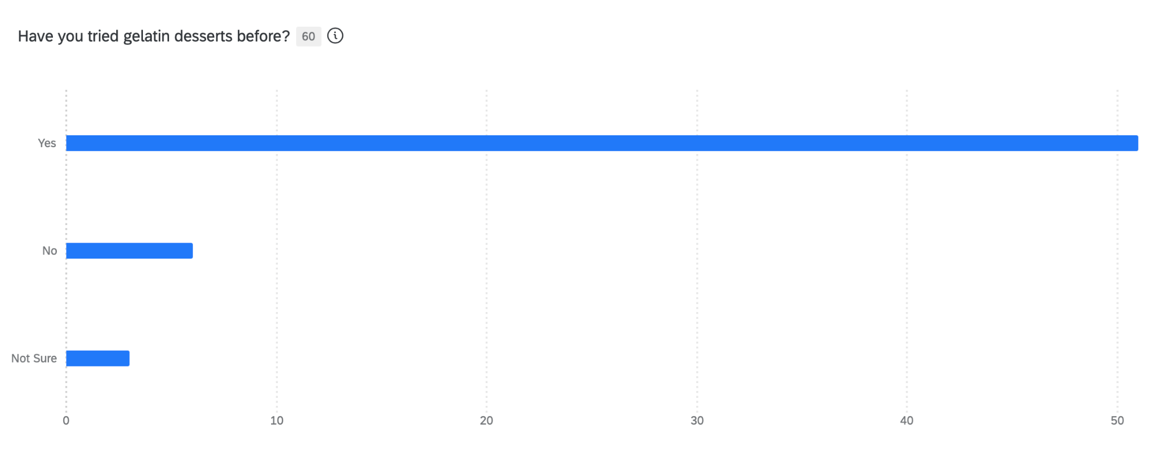
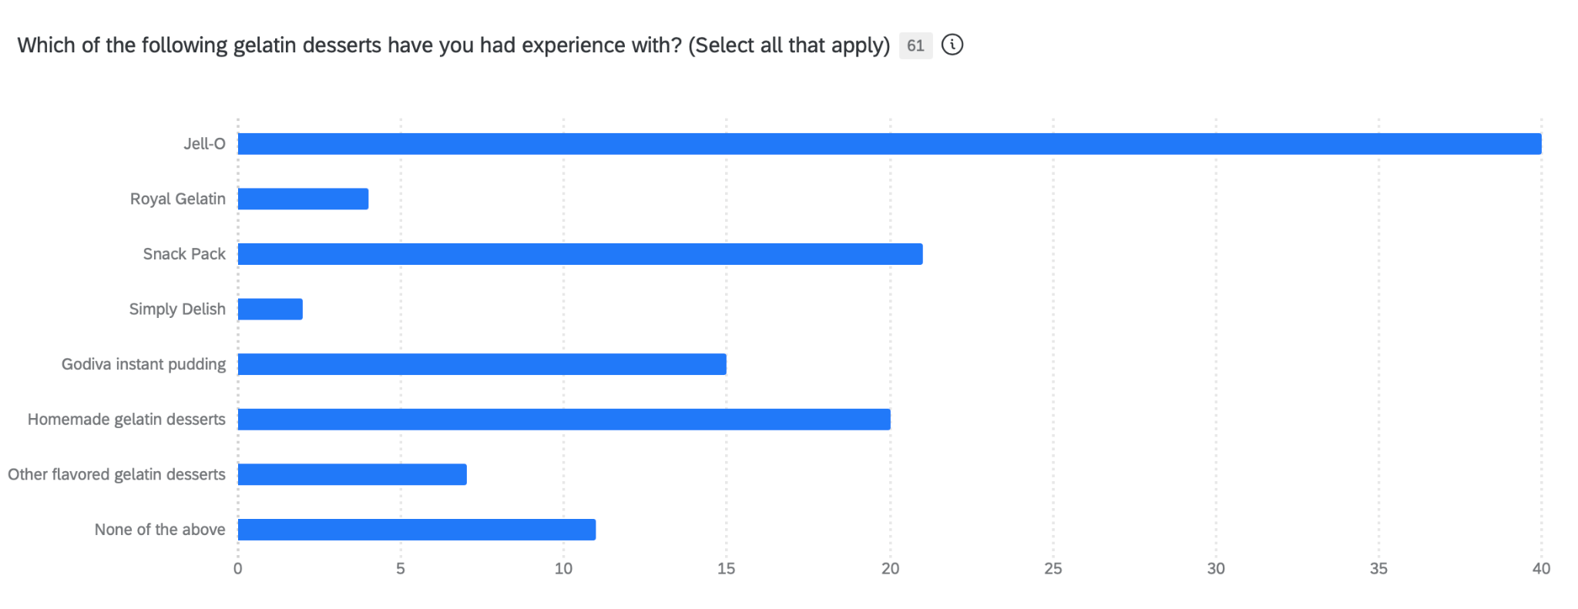
Survey Data
Total Number of Responses: 43
Q1.
A significant majority, 85% of respondents, have tried gelatin desserts, indicating strong familiarity and potential brand recognition for JELL-O products. This suggests a favorable market for introducing new variations like JELL-O PLAY Edible Slime.
Q2.
Jell-O leads with 66% brand familiarity among respondents, indicating strong recognition. Snack Pack follows at 34%, while brands like Royal Gelatin and Simply Delish show minimal awareness. Notably, 18% have no experience with gelatin desserts, highlighting potential market expansion opportunities.

Slide 23
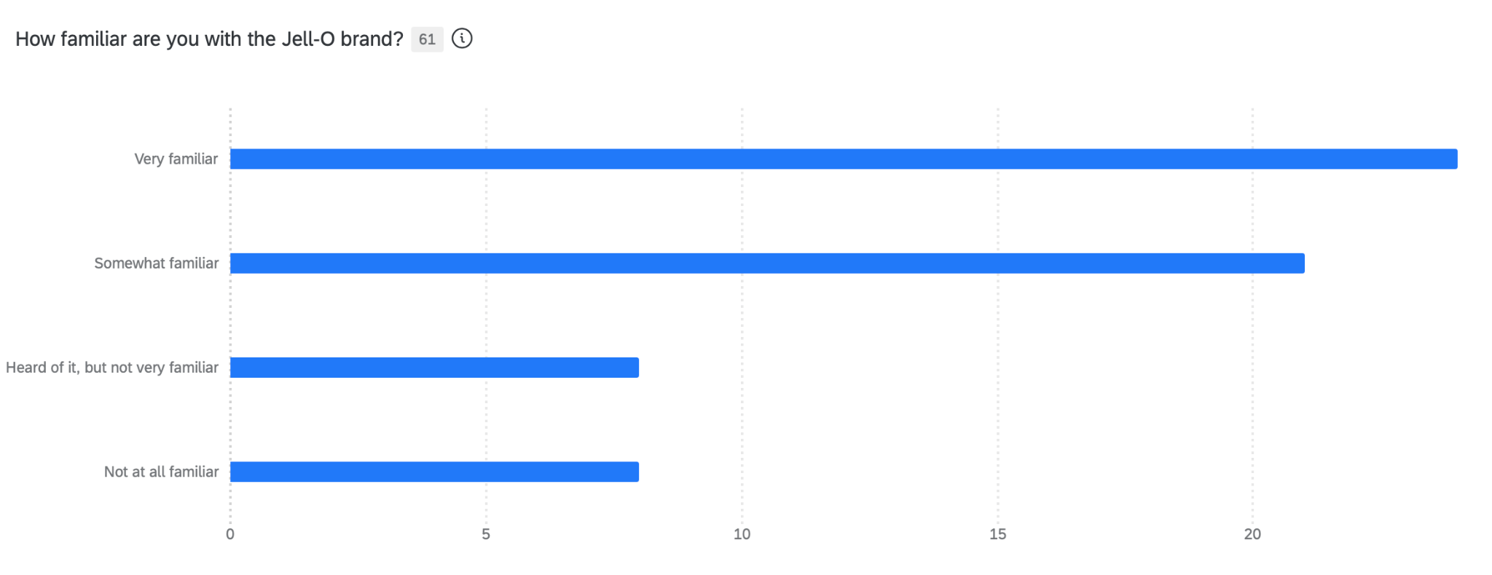
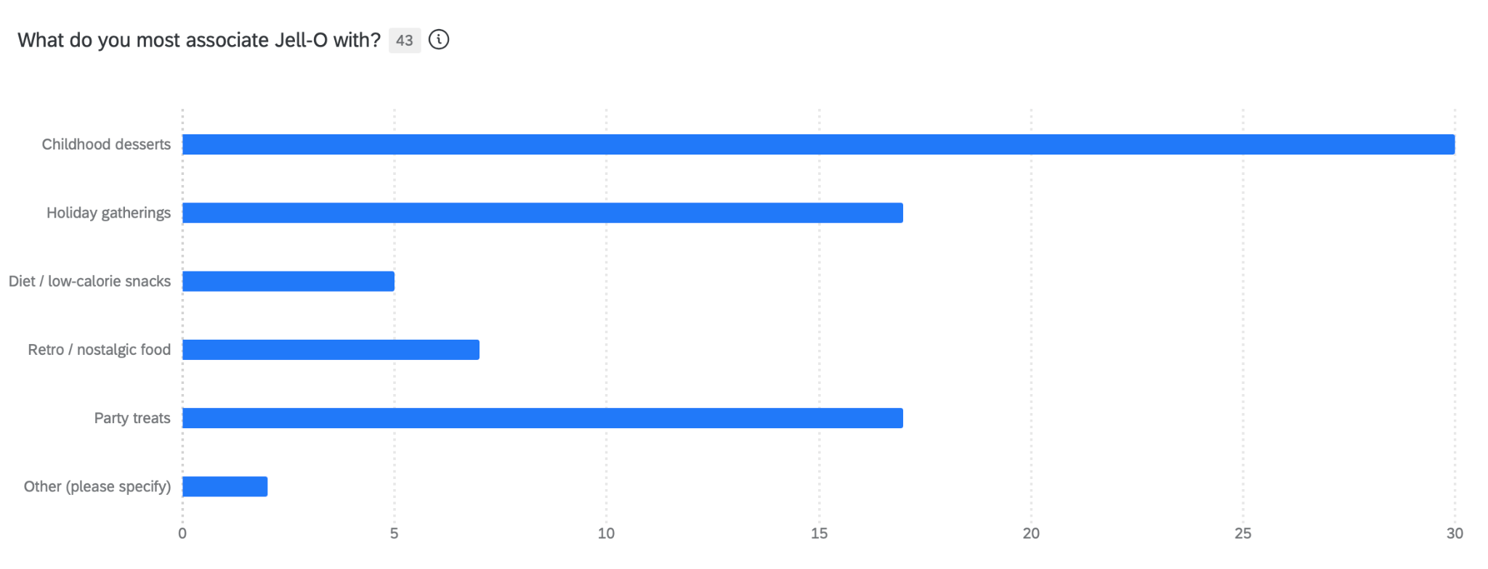
Survey Data
Total Number of Responses: 43
Q3.
A majority of respondents, 73%, are familiar with the Jell-O brand, indicating strong brand recognition. This familiarity suggests a solid foundation for introducing new products like JELL-O PLAY Edible Slime. However, 26% have limited awareness, highlighting an opportunity to increase brand engagement.
Q4.
A significant 70% of respondents associate Jell-O with childhood desserts, highlighting its nostalgic appeal. Additionally, 40% link it to holiday gatherings and party treats, reinforcing its role in social and festive occasions. Only 12% view it as a diet or low-calorie snack, indicating potential for repositioning in health-conscious markets.

Slide 24
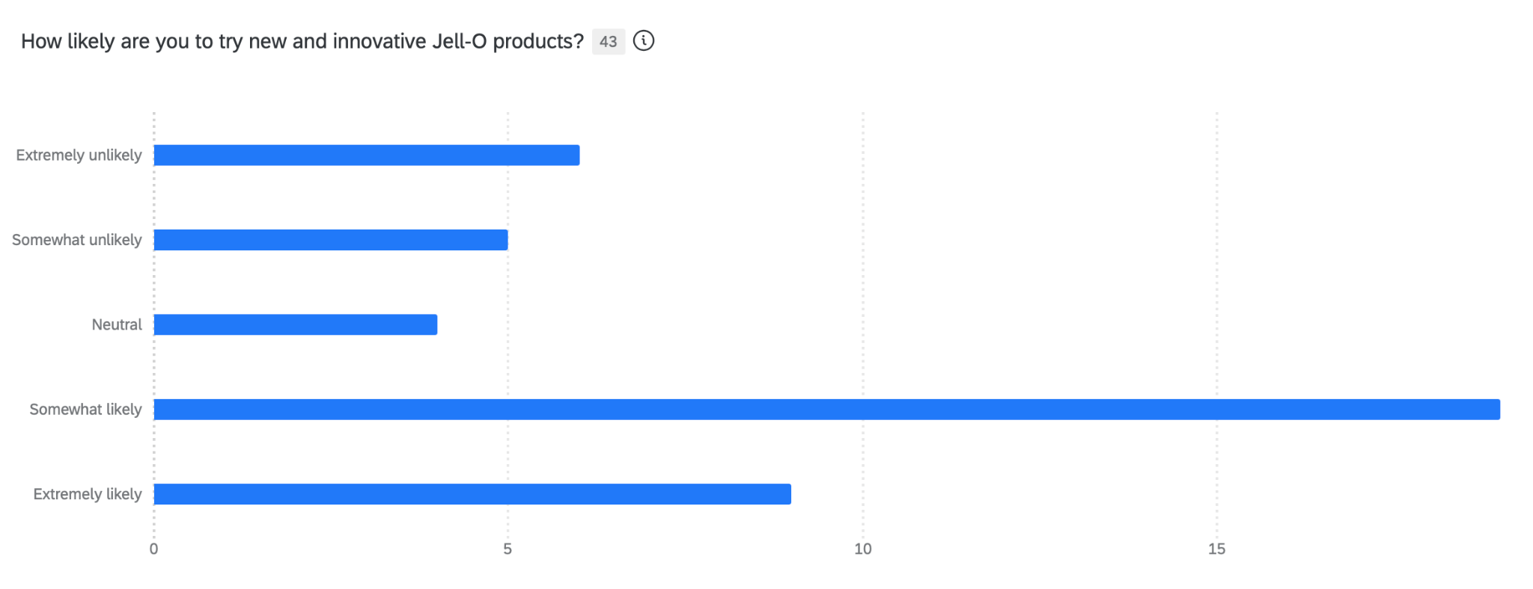
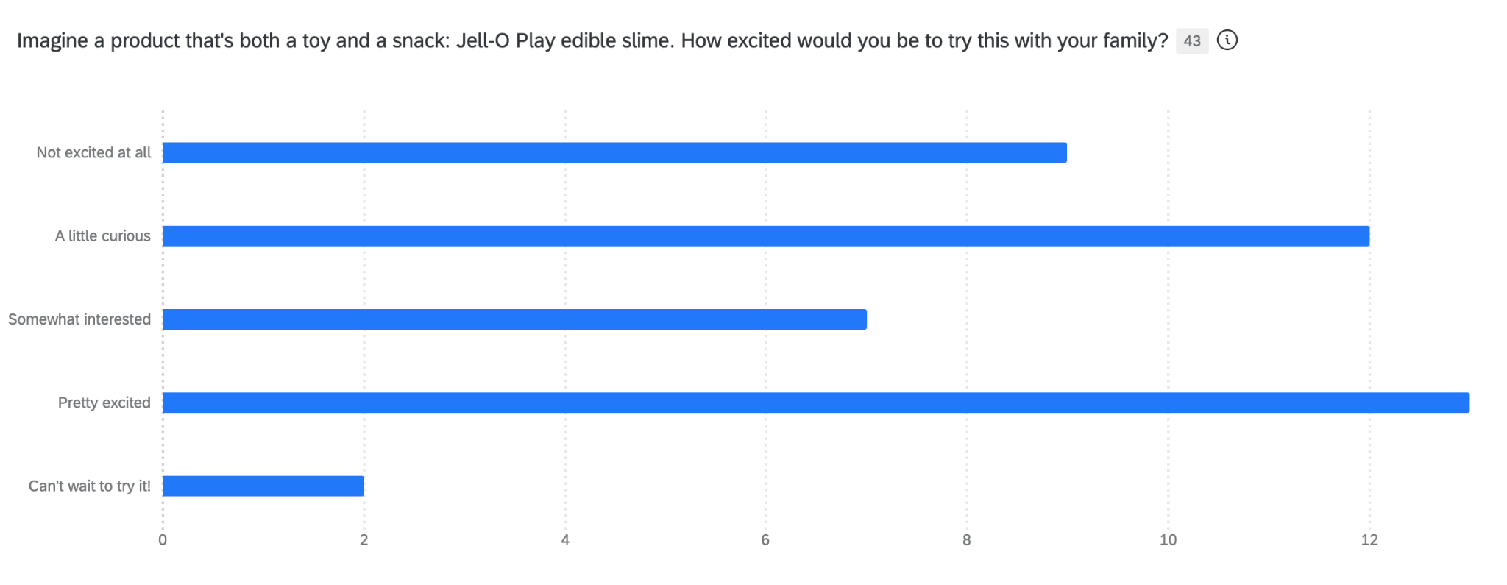
Survey Data
Total Number of Responses: 43
Q5.
A majority of respondents, 65%, are open to trying new and innovative Jell-O products, with 44% somewhat likely and 21% extremely likely. This indicates a strong potential market for introducing creative offerings like JELL-O PLAY Edible Slime.
Q6.
30% of respondents are "pretty excited" to try Jell-O Play edible slime, indicating a strong interest. Additionally, 16% are "somewhat interested" and 28% are "a little curious," suggesting potential for market engagement. However, 21% are not excited, highlighting a need for targeted marketing to increase appeal.

Slide 25
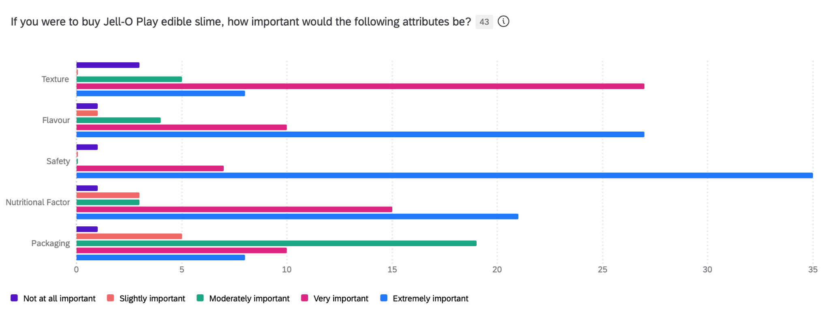
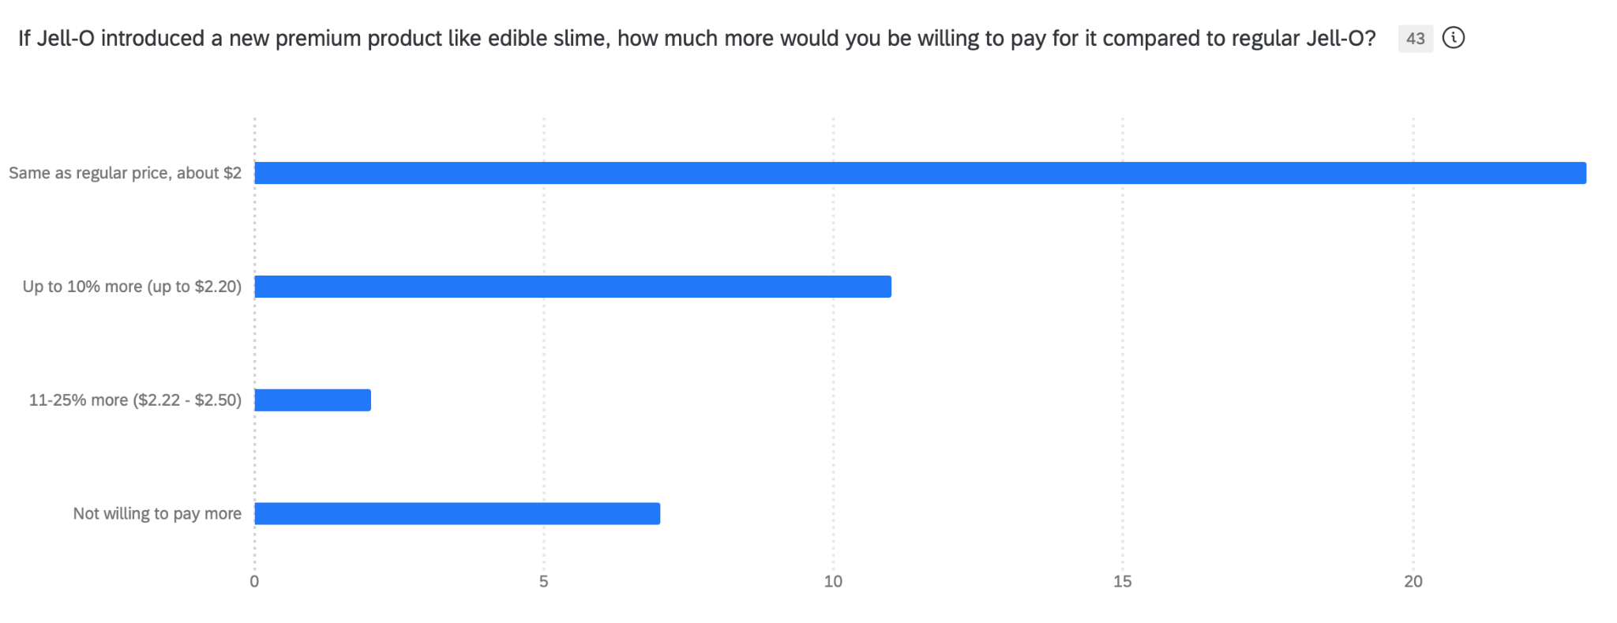
Survey Data
Total Number of Responses: 43
Q7.
Safety is the top priority for Jell-O Play edible slime, with 81.4% considering it extremely important. Flavor follows at 62.79%, and texture is crucial for 62.79%, emphasizing the need for a strong sensory experience.
Q8.
69% of respondents are unwilling to pay extra, and prefer to pay the same price for a new premium Jell-O product like edible slime, while 26% are open to paying up to 10% more.

Slide 26
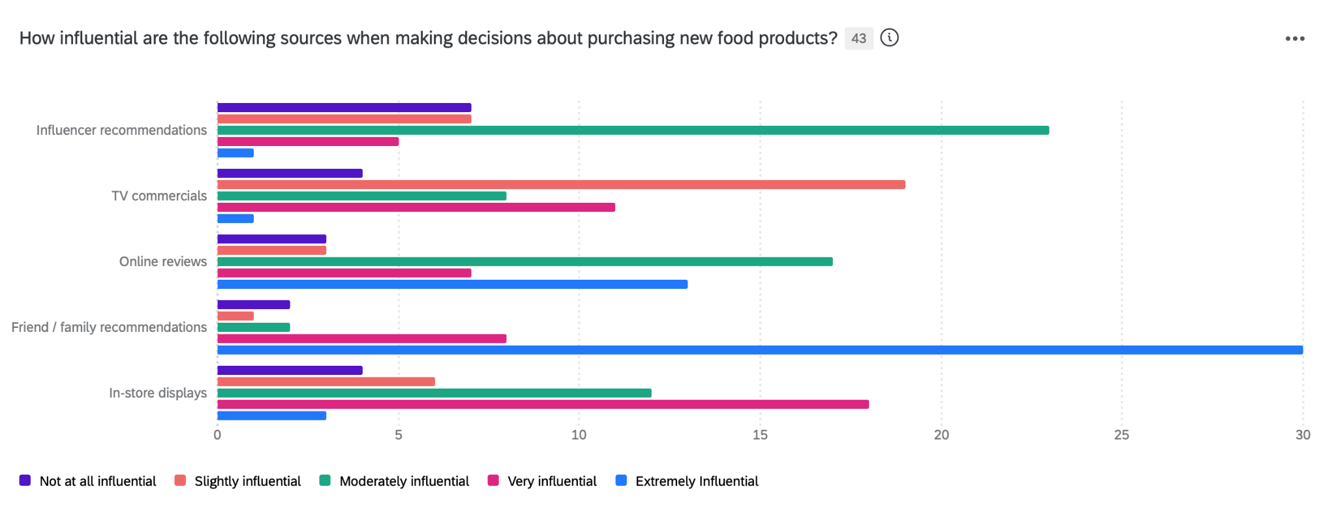
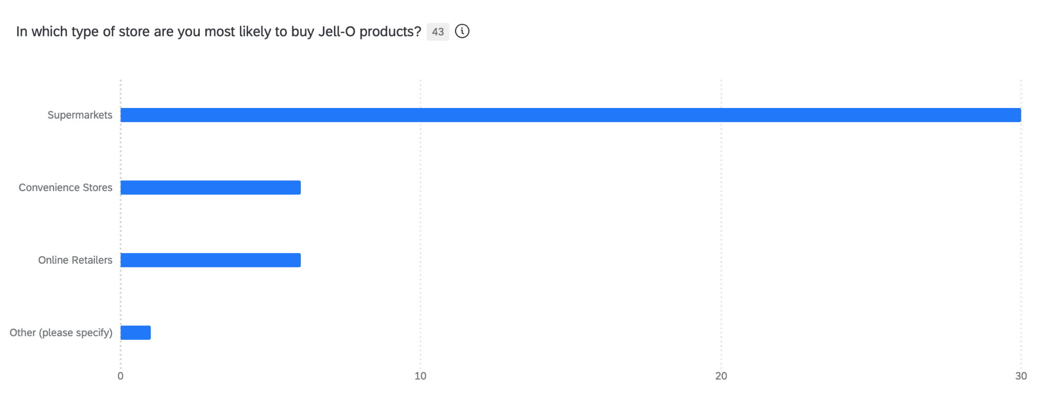
Survey Data
Total Number of Responses: 43
Q9.
Friend/family recommendations are the most trusted, with 69.77% finding them extremely influential. Online reviews are extremely influential for 30.23%, while in-store displays are very influential for 41.86%, highlighting their significant impact on purchasing decisions.
Q10.
70% of respondents prefer purchasing Jell-O products from supermarkets, indicating a strong preference for traditional retail channels. In contrast, 14% choose convenience stores and online retailers each, highlighting opportunities for expanding presence in these areas.

Slide 27
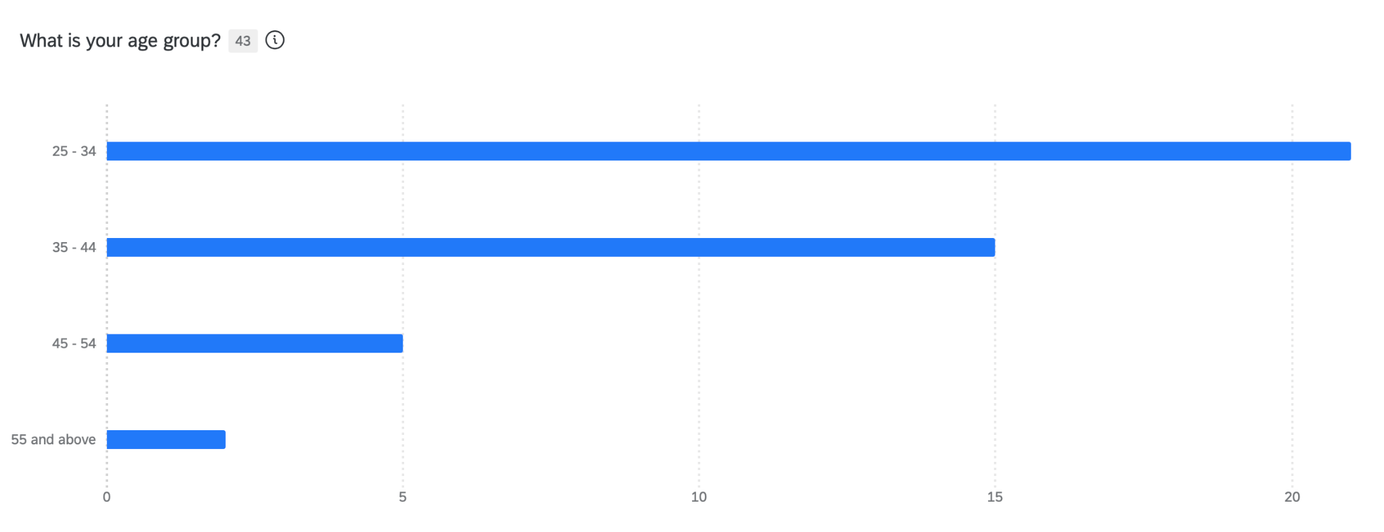
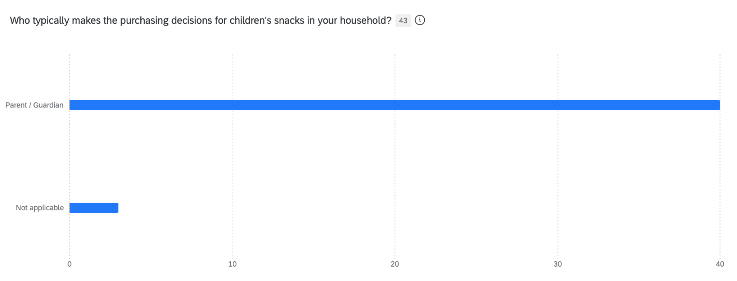
Survey Data
Total Number of Responses: 43
Q11.
49% of respondents are aged 25-34, indicating a youthful target market. The 35-44 age group follows at 35%, showing strong interest among younger to middle-aged adults, possibly millenial parents.. Only 17% are 45 and above, suggesting a focus on appealing to younger demographics.
Q12.
93% of respondents identify parents or guardians as the primary decision-makers for children's snacks, emphasizing the importance of targeting these individuals in marketing strategies. Only 7% indicated this was not applicable, highlighting a clear focus on parental influence in purchasing.

Slide 28
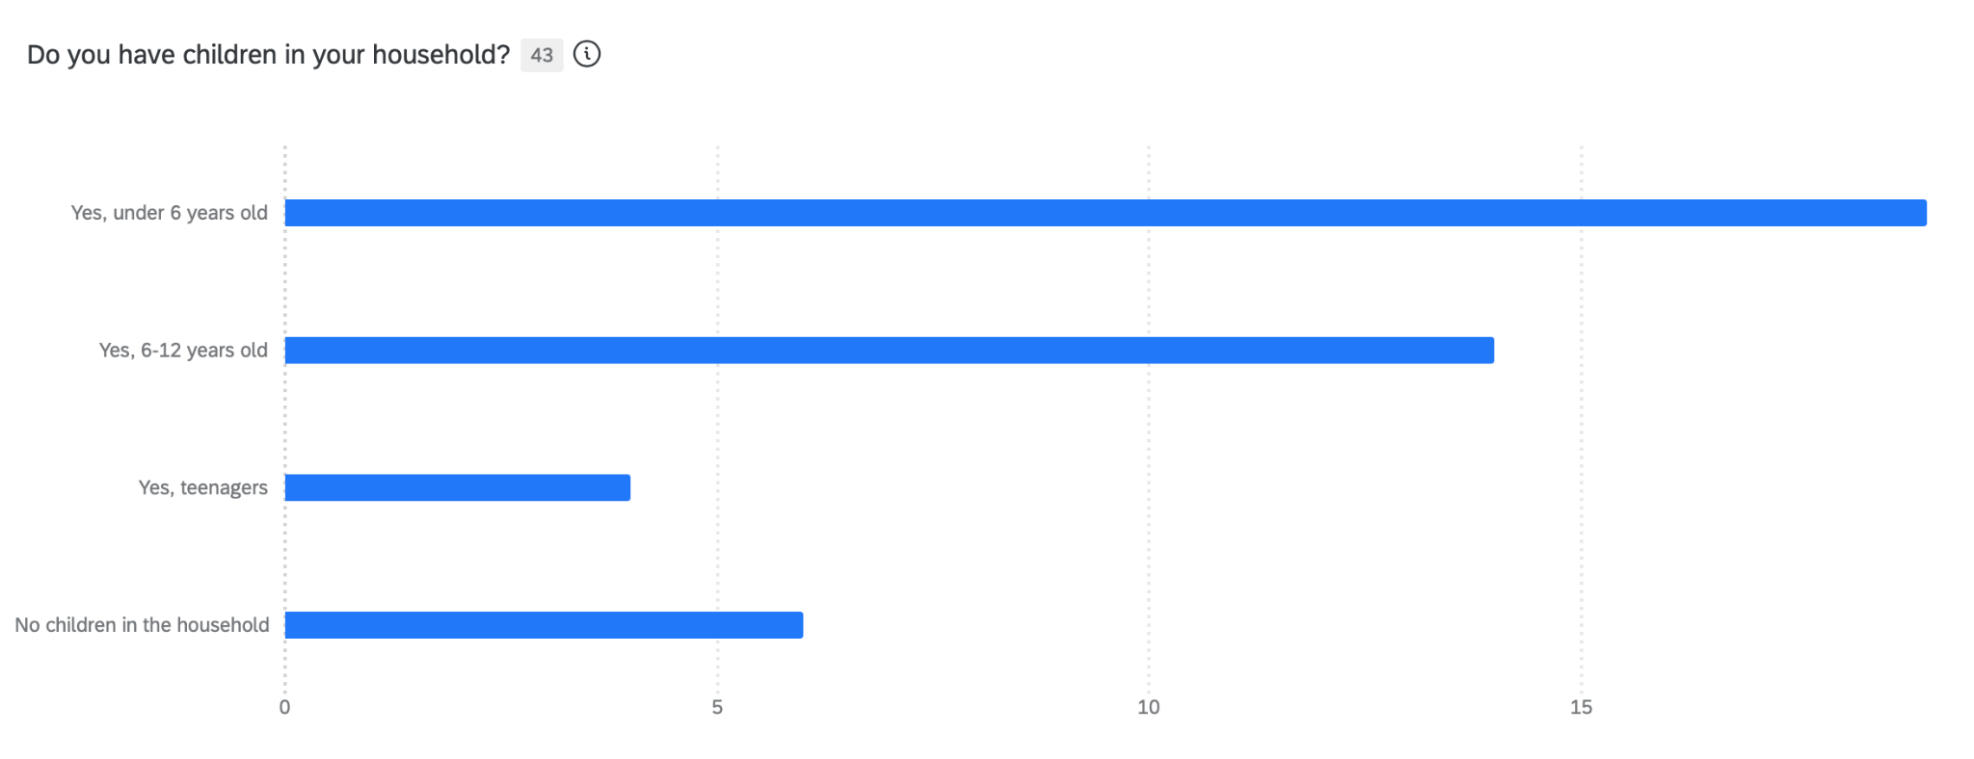
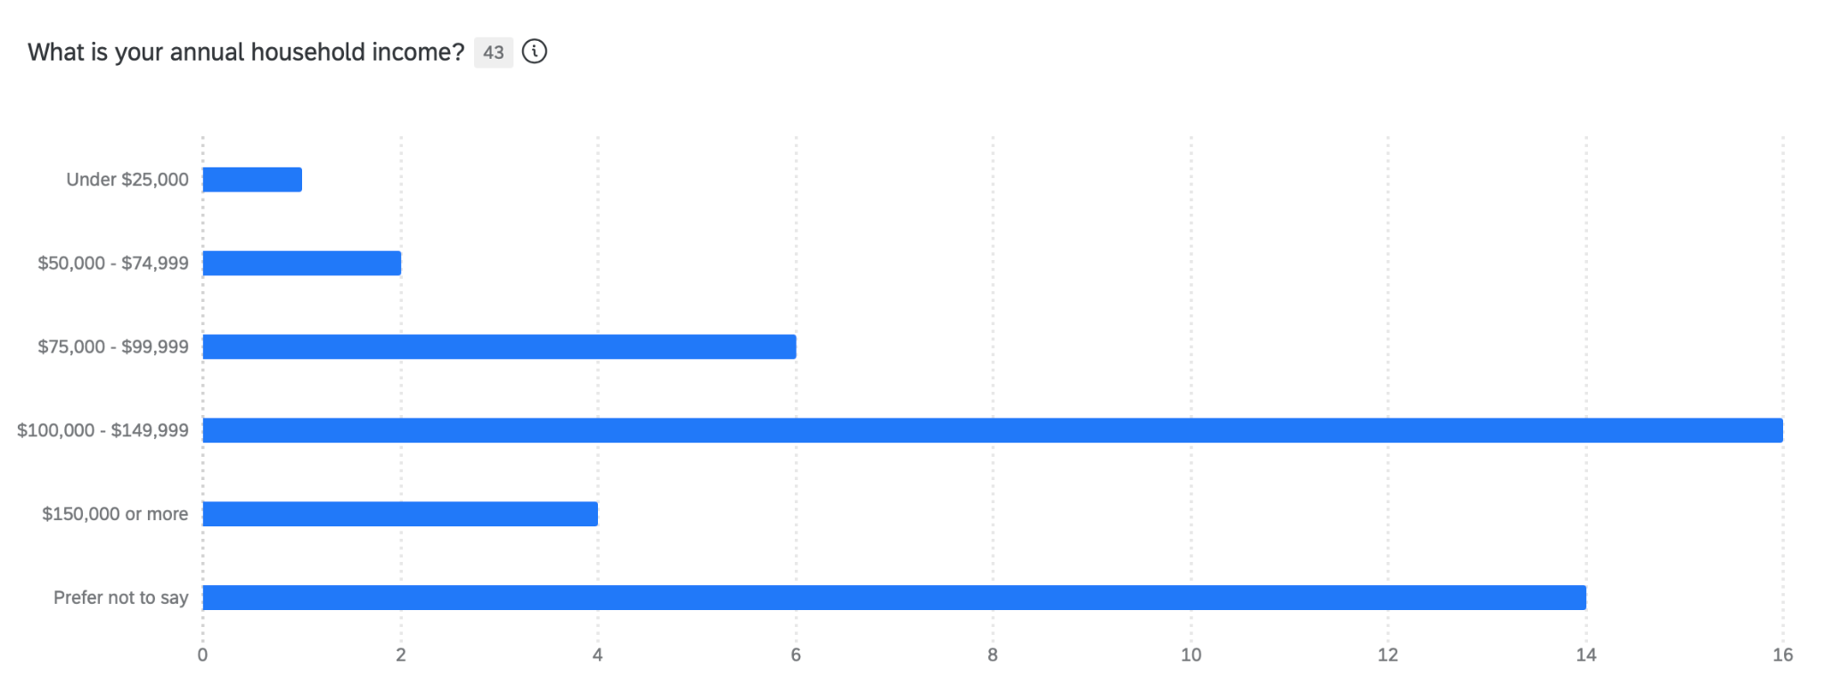
Survey Data
Total Number of Responses: 43
Q13.
44% of respondents have children under 6, and 33% have kids aged 6-12, indicating a strong focus on households with young children. Only 9% have teenagers, while 14% have no children, highlighting the primary target market for family-oriented products.
Q14.
37% of respondents have an annual household income of $100,000 to $149,999, indicating a substantial middle to upper-middle-income segment. Additionally, 14% earn $75,000 to $99,999, while 33% prefer not to disclose their income, suggesting potential privacy concerns or varied economic backgrounds.

Slide 29
Thank You!

